Slide 1


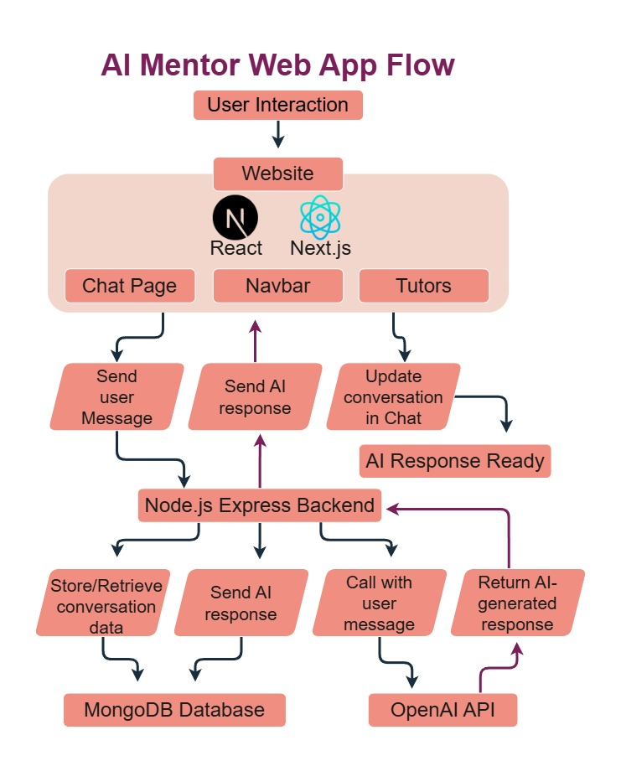


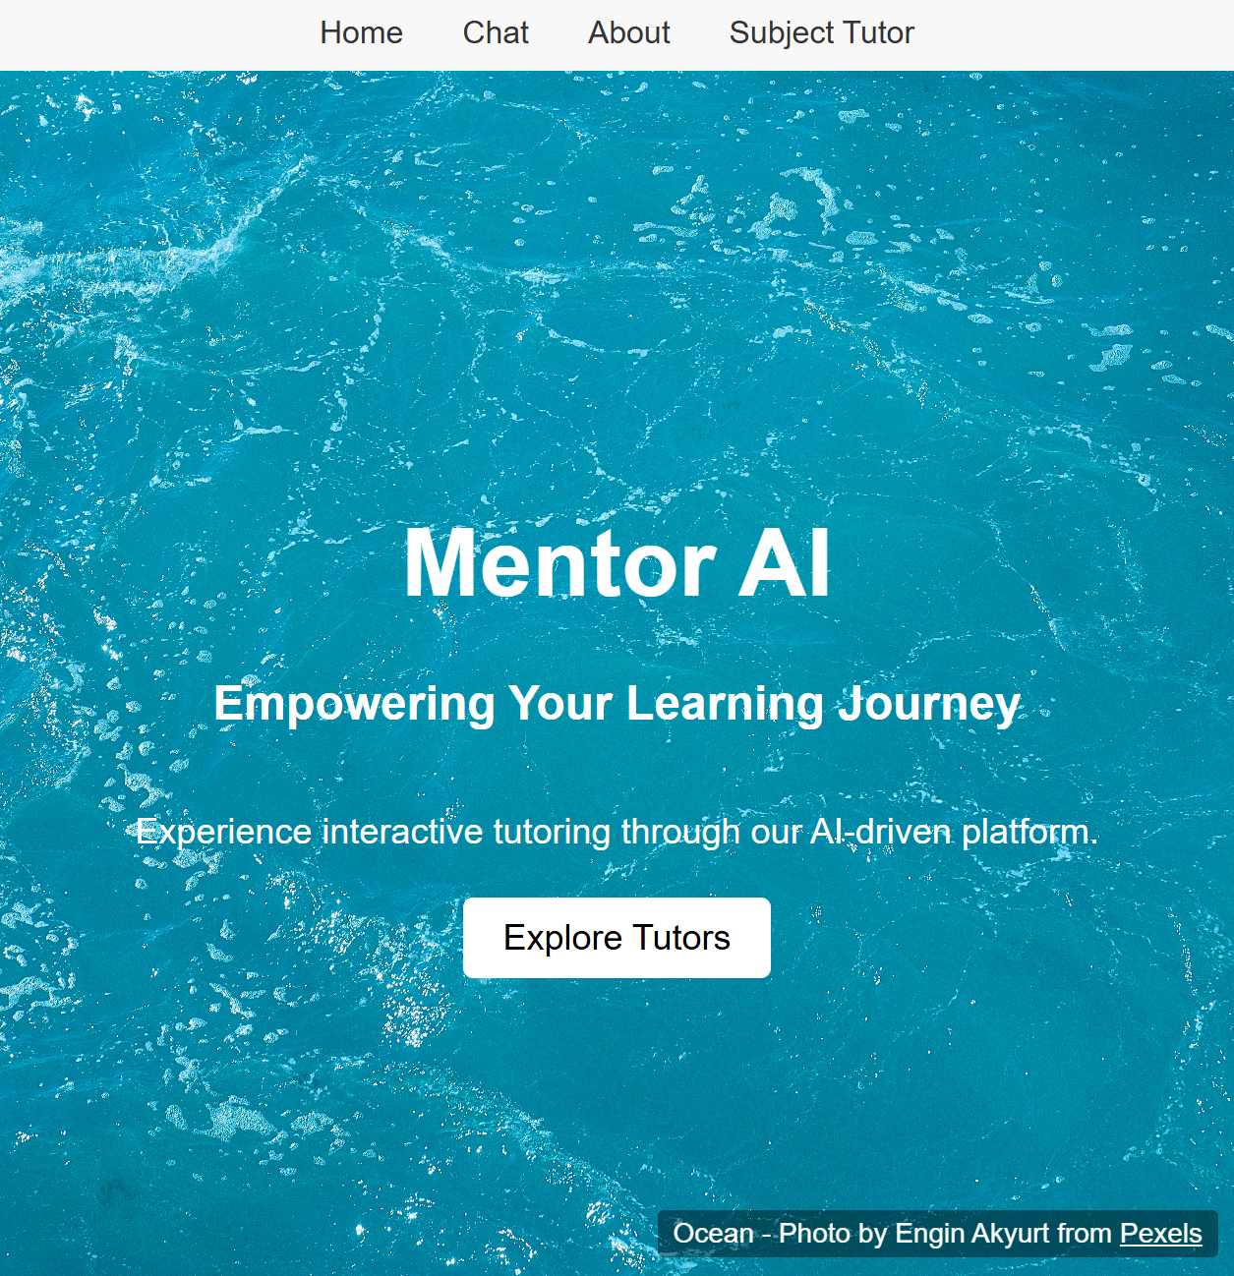
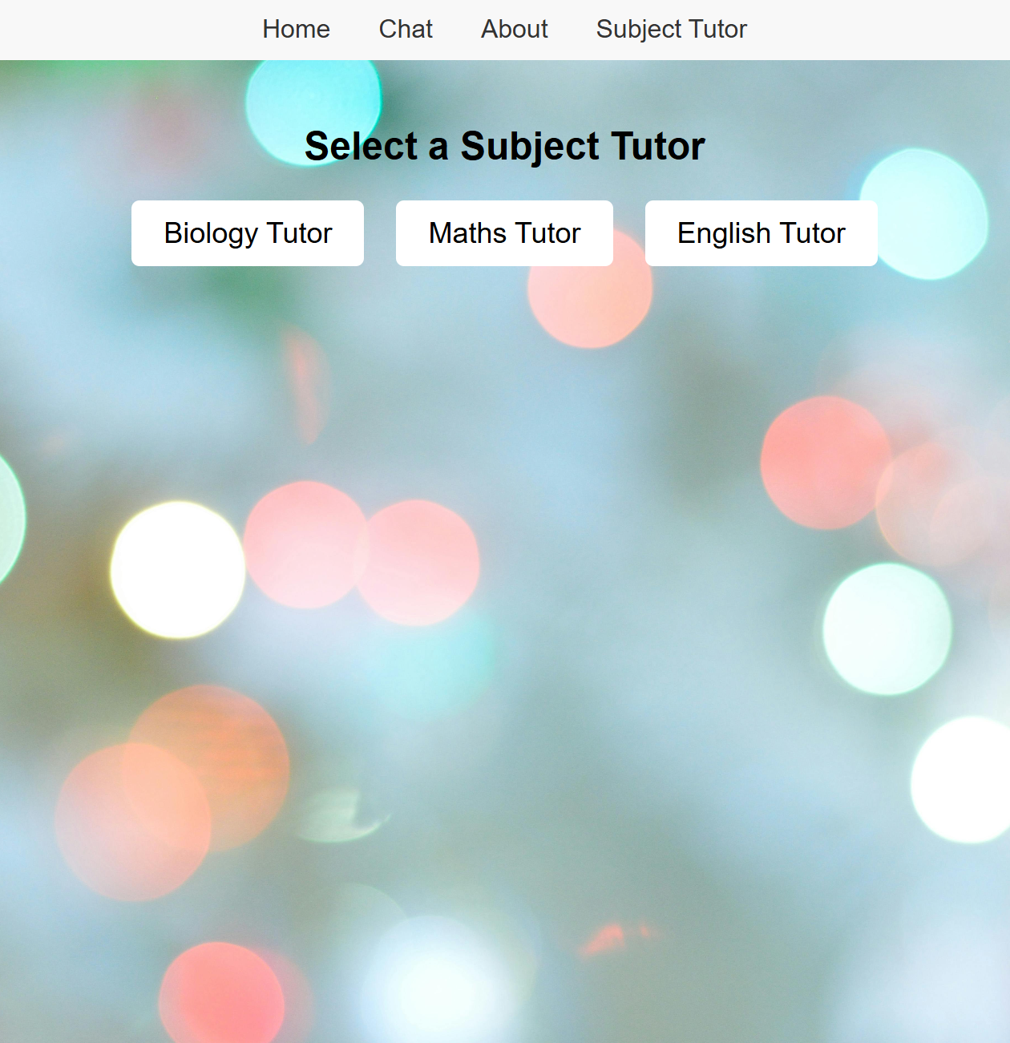
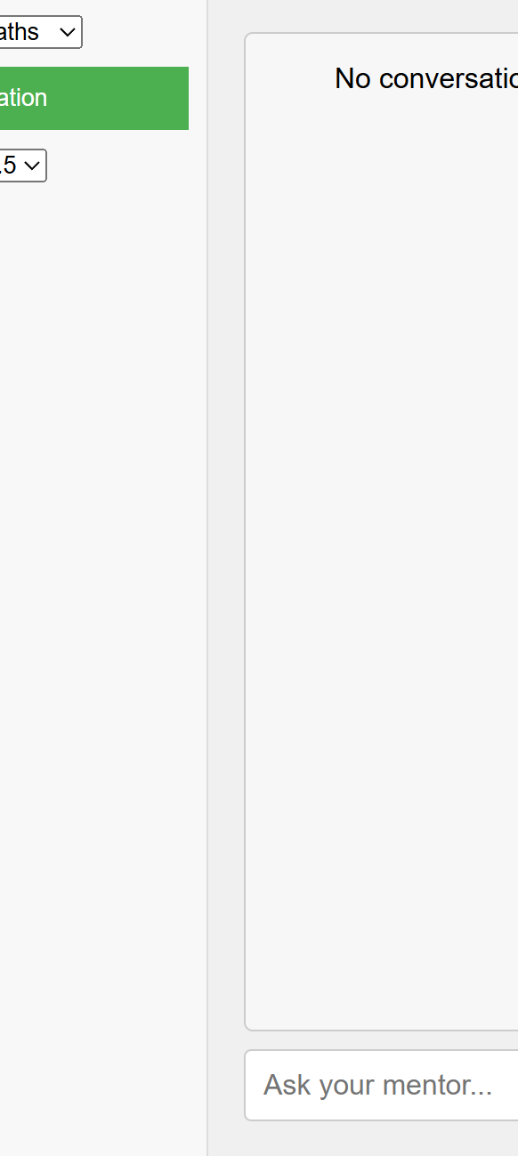




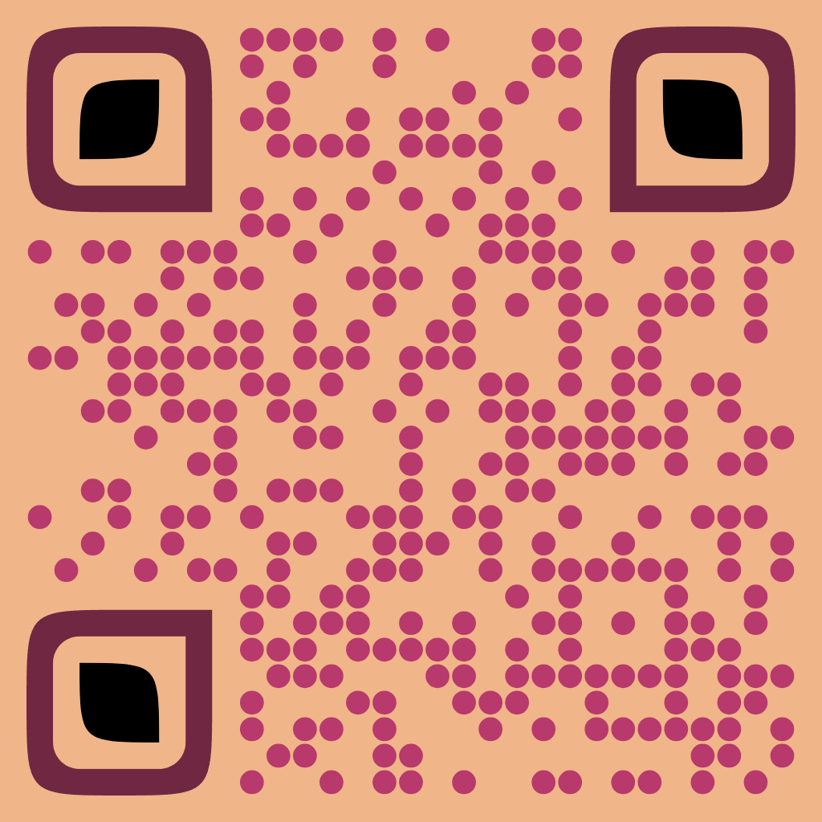

AI Mentor
BEng (Hons) Software & Electronic Engineering - Rakib Rana
Summary
Architecture Diagram
Technical Overview
I built an AI Mentor to make studying feel less like a chore and more like having a conversation with a friendly expert.
Whether it’s biology, math, or Python, the system breaks down tough concepts into clear steps and adjusts to your level.
The Chat experience is dynamic and will be personalised over time.
The Chat page is where users type questions and receive AI-generated answers in real time.
This work-flow starts at the top with a user interacting through the website.
- The AI Mentor app uses React for a smooth front- end interface, Node.js for all the backend, and OpenAI’s GPT-3.5 models and Api’s to power the backend.
- Each tutor remembers your progress, and you can switch subjects whenever you want.
Database(MongoDB): Stores each conversation, so the AI can recall previous questions and adapt its explanations accordingly.
Offered scalability and user friendly use, as more models can be added over time, increasing learning throughput.
The Navbar helps users move around the site to the home page, chat page, or about section.
Model
Project
The AI Model’s database have been fine-tuned and modelled ranging from various sources such as Wikipedia, Stack Overflow and OpenStax dumps.
Biology Tutor
Maths Tutor
Python Tutor

